Slide 1
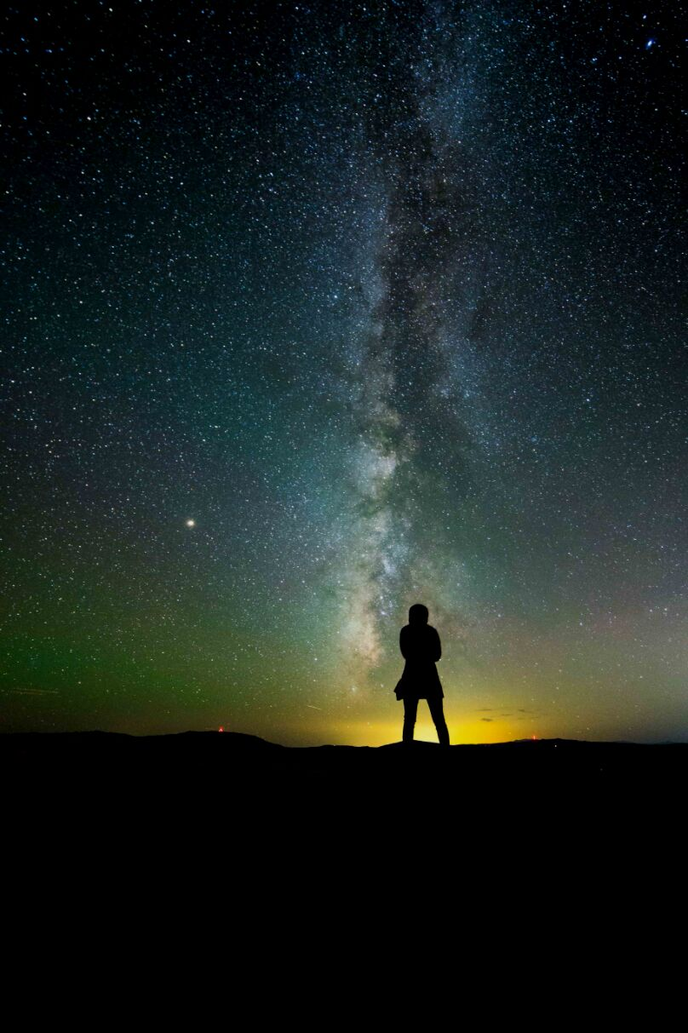
IN NM, WE ARE LUCKY!
ONLY 2 OUT OF 10 PEOPLE ON EARTH CAN SEE THE MILKY WAY
99% OF THE USA AND EUROPE LIVE UNDER LIGHT POLLUTED SKIES
MANY MAY ONLY SEE A HANDFUL OF STARS
IN NM, WE ARE LUCKY! …… FOR NOW
DarkSky International | 2024
Notes:
So, have you had the experience of being under a truly natural dark night sky?
Who here has seen the milky way? Who thinks they have to drive the farthest to see it?
Unfortunately, today only 1 in 10 people in the world live under skies that reach the level of natural darkness.

Slide 2
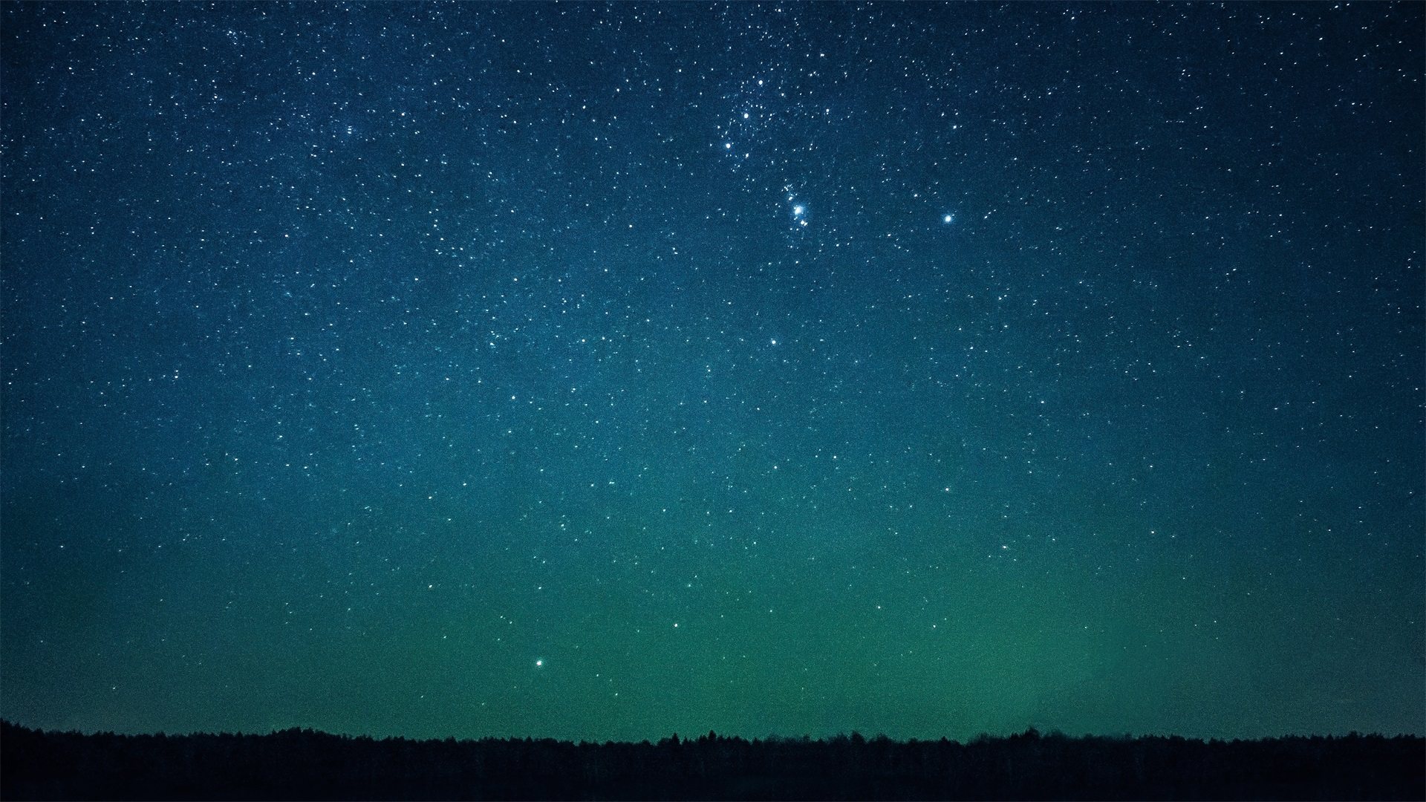
Why care about dark skies?
Cultural heritage and perspective on our location in the Universe
Ecological impacts
Human safety and health
Energy and money savings
Science
Economic impact

Slide 3
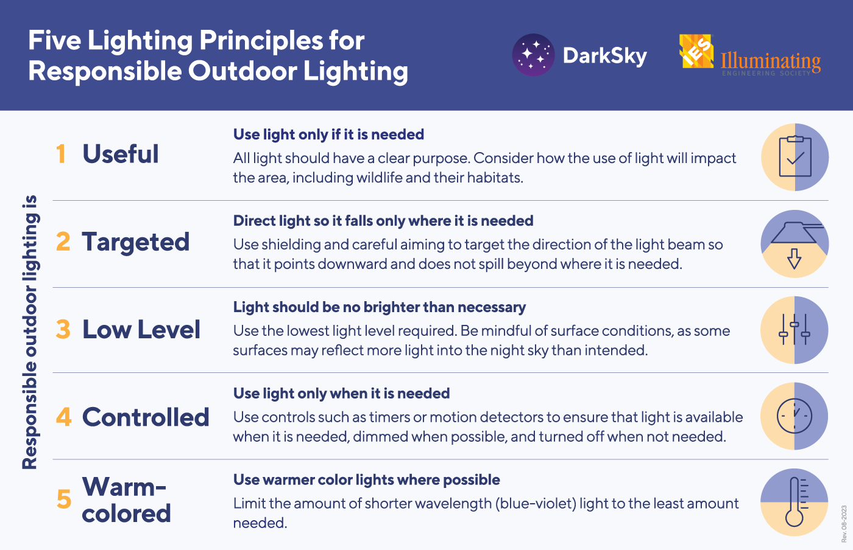
Notes:
The solutions are generally the same, whether you’re concerned about human health, safety/security, wildlife, energy conservation, or astronomy. And DarkSky International has condensed them down into these 5 principles of responsible outdoor lighting.
Useful - First decide if you really need the light. Is the lighting warranted?
If a light is there just to look pretty, perhaps turn it off and see pretty the natural night sky can be ☺

Slide 4
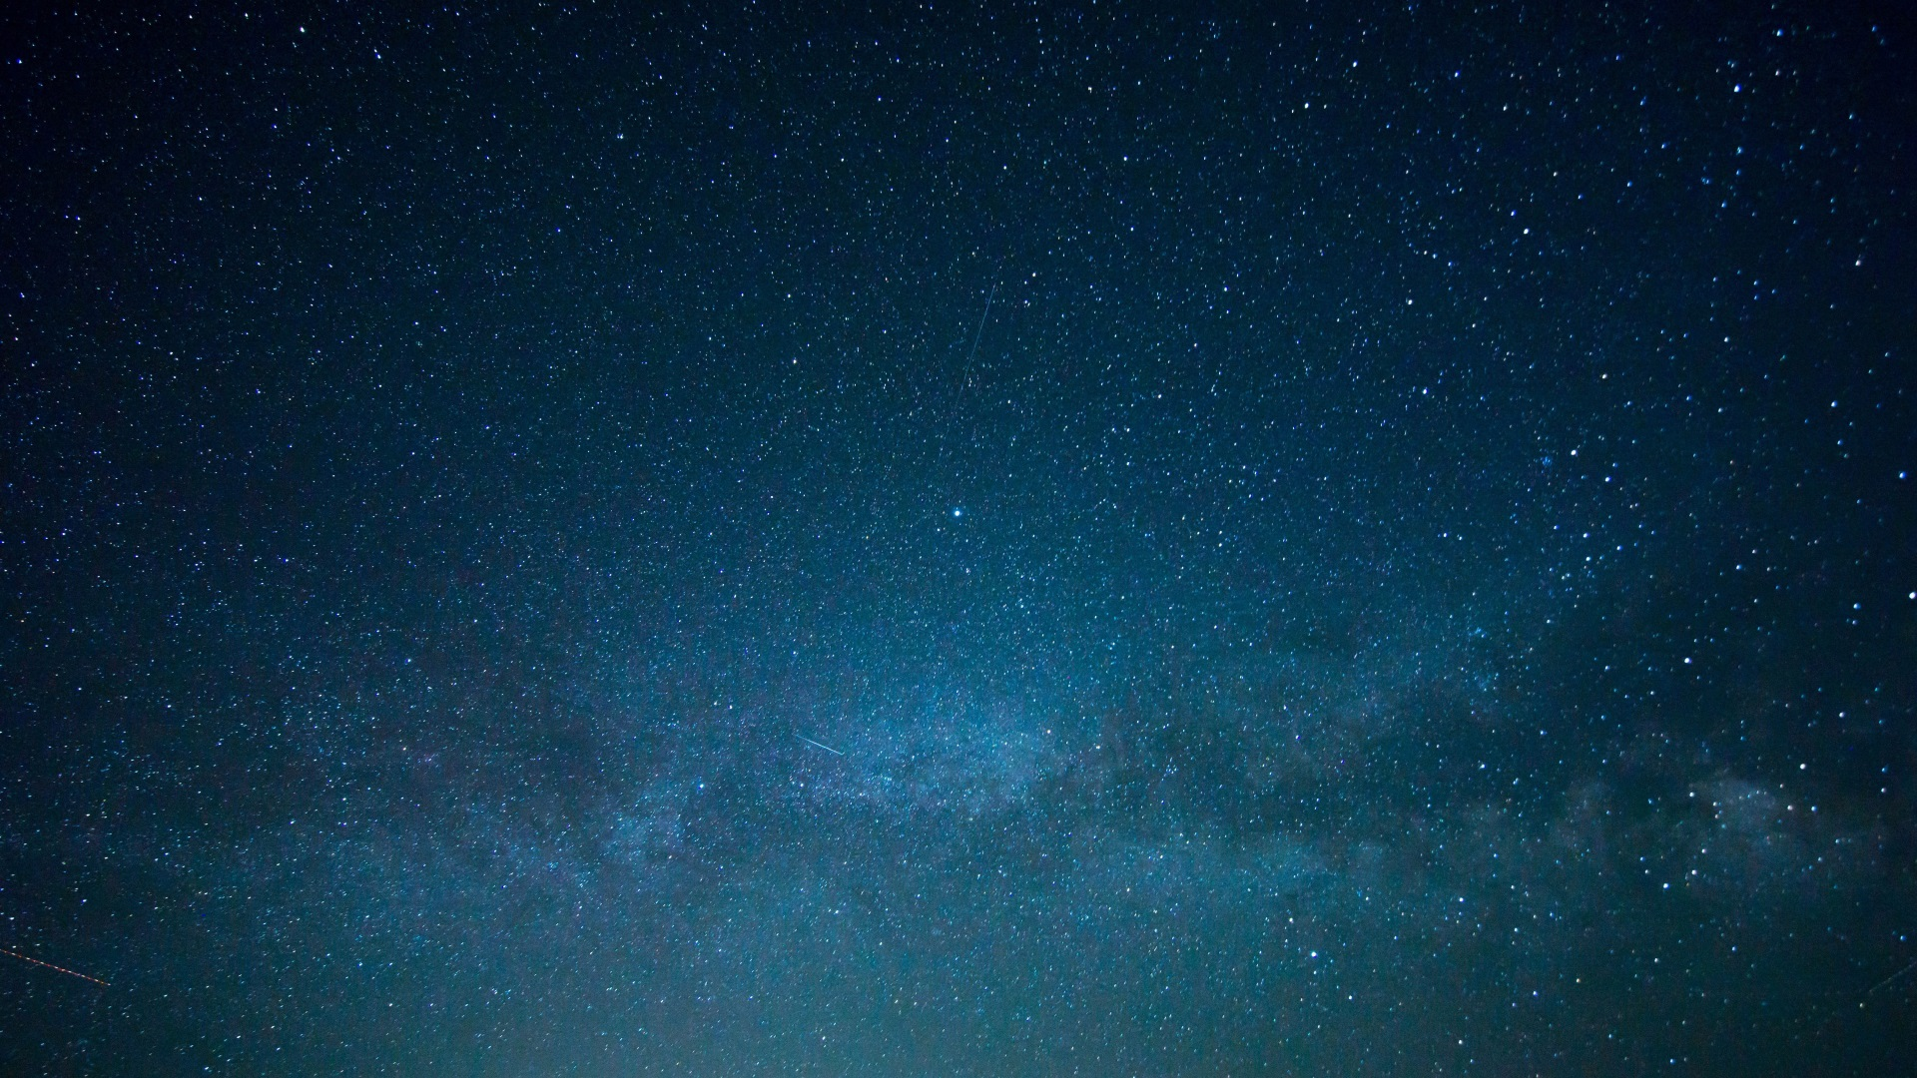
Keeping our skies darker is a win-win proposition!
Better for humans
Better for wildlife
Better for energy consumption
Better for budgets
Better for safety
Good for the economy
Put light only where and when it is needed!

